Slide 1

Analysing and Interpreting Data
Introduction to Analytics and Plotting
2023

Slide 2
ANALYSIS AND INTERPRETATION The process of data analysis can be broken down into 5 steps, that are universally recognized
Define Question
Data Collection
Data Cleansing
Data analysis
Interpretation
Determine the objective: What problem are we going to solve?
Set up hypothesis
Clear focus of goal helps to determine the type of analysis
What data is accessible? 1st party, 2nd party, 3rd party?
Volume of data? Full dataset or representative sample?
Check for inconsitencies and incompletness
Remove duplicates
Search for outliers
Dealing with NULL values
30% of the time is spent on this step
Exploratory analysis: Uncover insights before analysis
Diagnostic analysis: Searching for the cause,
Descriptive analysis: summarizing data
Predictive analysis: Forecast future events
Prescriptive analysis: Make future recommandations
Data visualization can help with data interpretation
Communication to stakeholders
Notes:
1st party: First party, also known as 1P, data is data that a company collects directly from customers.
2nd party: Second party data is first-party data given to you from a trusted partner or company.
3rd party: Third party data is any data collected by an organization or entity that doesn’t have a direct relationship with the individual the data is being collected from.
https://towardsdatascience.com/the-complete-roadmap-to-becoming-a-data-analyst-with-no-previous-experience-952c5b3a7cbc

Slide 3
ANALYSIS AND INTERPRETATION The process of data analysis can be broken down into 5 steps, that are universally recognized
Define Question
Data Collection
Data Cleansing
Data analysis
Interpretation
Data Visualization can support in different areas
Notes:
https://towardsdatascience.com/the-complete-roadmap-to-becoming-a-data-analyst-with-no-previous-experience-952c5b3a7cbc
https://www.geeksforgeeks.org/six-steps-of-data-analysis-process/

Slide 4
ANALYSIS AND INTERPRETATION The analytical process can be summarised as a cycle with three main steps
1
Break the question down into hypotheses
Consolidate results & dig deeper
3
2
Find concrete measures to verify or reject them

Slide 5
ANALYSIS AND INTERPRETATION The analytical process can be summarised as a cycle with three main steps
1
Break the question down into hypotheses
Consolidate results & dig deeper
3
2
Find concrete measures to verify or reject them

Slide 6
ANALYSIS AND INTERPRETATION The analysts’ job is to break big questions into smaller ones that can be answered with data...
Leading Question
e.g.
Why are users leaving our platform?
Hypothesis 1
Hypothesis 2
Hypothesis 3
e.g.
Are they having bad experiences ?
e.g.
What is the satisfaction score over time for users in Berlin?
Analyses
Analyses
Analyses

Slide 7
ANALYSIS AND INTERPRETATION There are many ways to come up with hypotheses, but here are some examples
Intuition
If it makes intuitive sense, it’s a great idea to explore it
Exploratory Analysis
Playing around with data, looking for patterns, correlations, and things that look “out of place”
Standard Approaches
Many types of problems already have a well known approach! e.g. Funnels, Marketing Analytics, etc.
Expert Knowledge
If someone has 30 years of experience with a topic, their gut feeling is a great place to start to find hypotheses

Slide 8
ANALYSIS AND INTERPRETATION The analytical process can be summarised as a cycle with three main steps
1
Break the question down into hypotheses
2
Find concrete measures to verify or reject them
Consolidate results & dig deeper
3

Slide 9
ANALYSIS AND INTERPRETATION How do you know a measure verifies or rejects a hypothesis?
Will the metric change if the hypothesis were true/false?
Will the metric change due to other factors?

Slide 10
ANALYSIS AND INTERPRETATION The analytical process can be summarised as a cycle with three main steps
1
Break the question down into hypotheses
Consolidate results & dig deeper
3
2
Find concrete measures to verify or reject them

Slide 11
ANALYSIS AND INTERPRETATION Start over!
WHY?
WHY?
WHY?

Slide 12
PRACTICE So where do we go from here?
We’re going to review different kinds of plots and the questions they can answer (today and in the next few classes)
You’re going to answer an analytical question using the method we discussed today and any or all of these
Finally, you will learn how to modify these plots to tell the story you need to tell

Slide 13
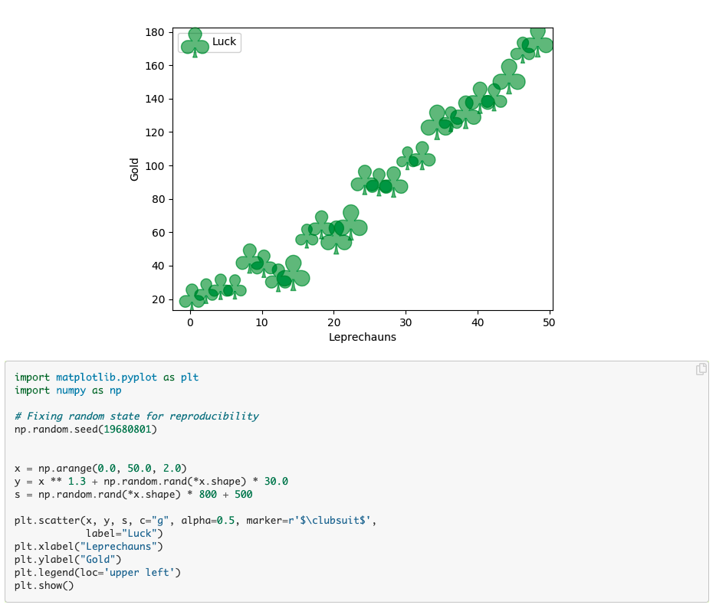
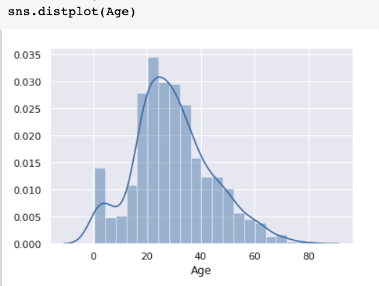
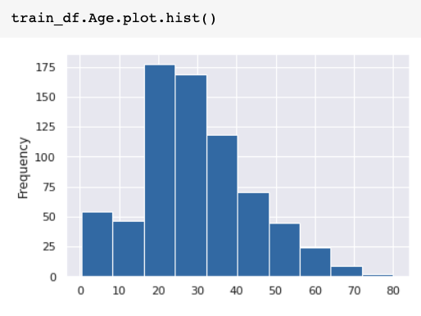
PRACTICE - BASICS Plotting libraries for Python
Pandas build-in plot function
Seaborn
Matplotlib
Ease of use
Flexibility

Slide 14
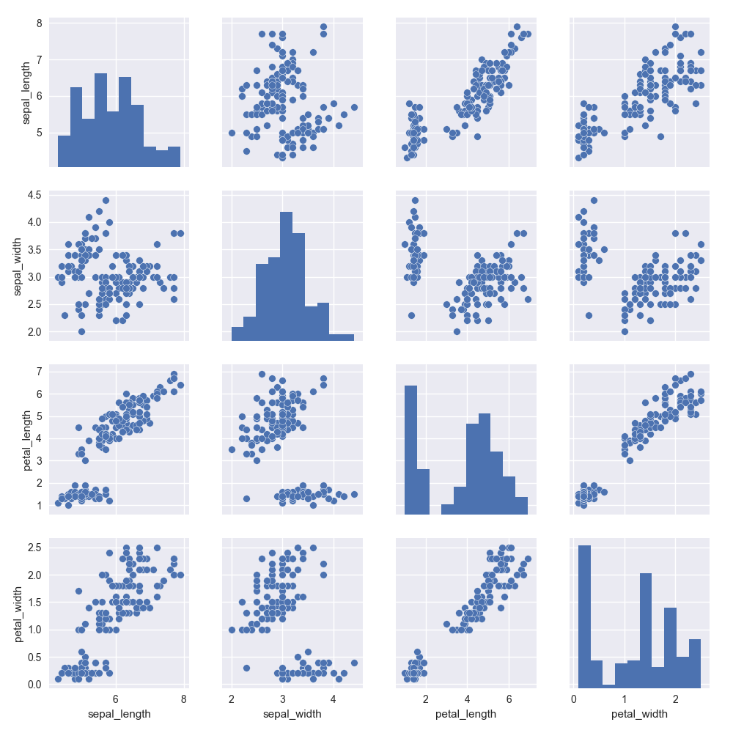
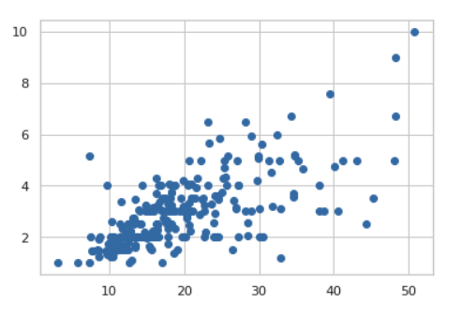
PRACTICE - BASICS Types of plots and which questions they answer
Univariate
Bivariate
Multivariate
How does this variable behave?
How is it distributed?
Are there outliers?
Does it reflect more than one population?
How do these two variables correlate?
Does a change in one predict a change in the other?
How strongly or weakly do they correlate?
What possible correlations can we find?
Does a joint change in a set of variables predict a change on our target variable?
Notes:
Univariante: Age -> Histogram

Slide 15
ANALYSIS AND INTERPRETATION How to choose the right plot for your problem?
Think about what you want to model
Change over time
Comparison
Part of a whole
A Correlation
Ranking
Distribution
Flows and relationships
Geospatial
Source https://flourish.studio/2018/09/28/choosing-the-right-visualisation/

Slide 16
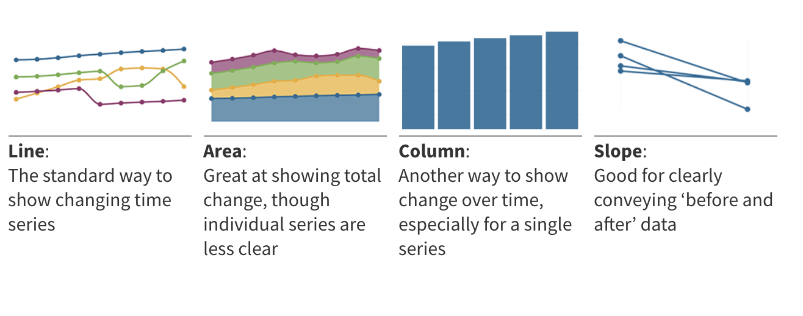
ANALYSIS AND INTERPRETATION Model change over time
Source https://flourish.studio/2018/09/28/choosing-the-right-visualisation/

Slide 17
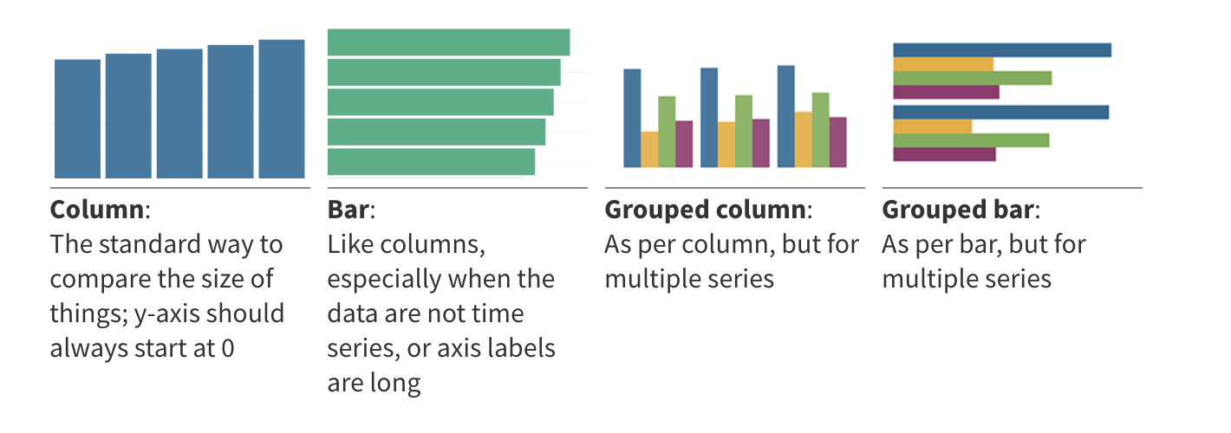
ANALYSIS AND INTERPRETATION Model comparison
Source https://flourish.studio/2018/09/28/choosing-the-right-visualisation/

Slide 18
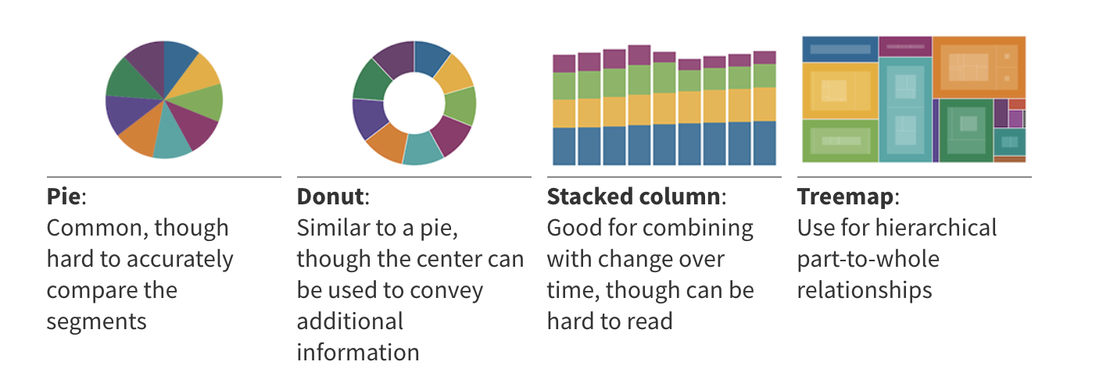
ANALYSIS AND INTERPRETATION Model part of a whole
Source https://flourish.studio/2018/09/28/choosing-the-right-visualisation/

Slide 19
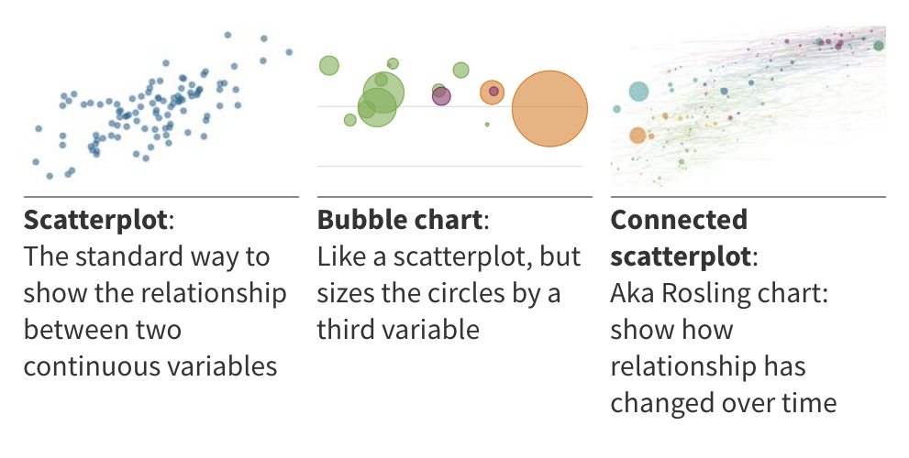
ANALYSIS AND INTERPRETATION Model Correlation
Source https://flourish.studio/2018/09/28/choosing-the-right-visualisation/

Slide 20
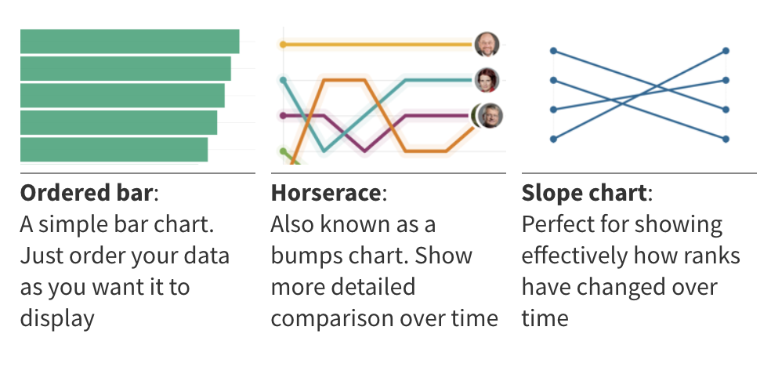
ANALYSIS AND INTERPRETATION Model Ranking
Source https://flourish.studio/2018/09/28/choosing-the-right-visualisation/

Slide 21
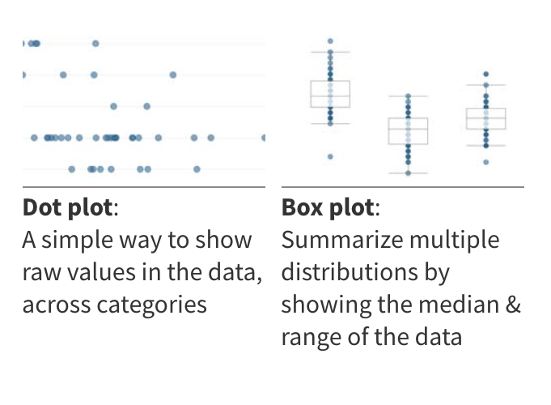
ANALYSIS AND INTERPRETATION Model Distribution
Source https://flourish.studio/2018/09/28/choosing-the-right-visualisation/

Slide 22
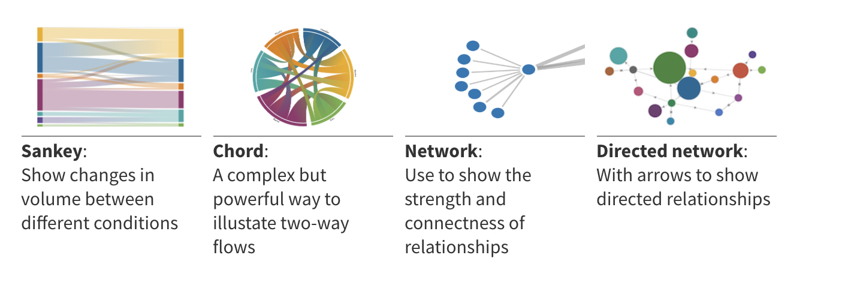
ANALYSIS AND INTERPRETATION Model Flows and relationship
Source https://flourish.studio/2018/09/28/choosing-the-right-visualisation/

Slide 23
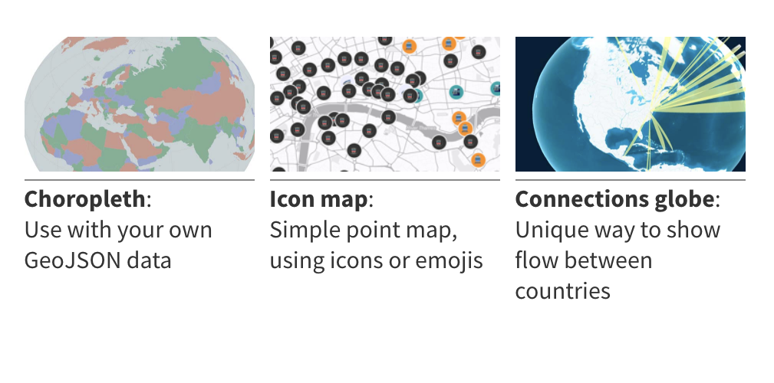
ANALYSIS AND INTERPRETATION Model geospatial
Source https://flourish.studio/2018/09/28/choosing-the-right-visualisation/

Slide 24
COURSE CONTENT AND STRUCTURE We have discussed several techniques to load, and analyse data
Question
Get the data
Explore the data
Model the data
Communicate the results
Foundations
Python Data Types, Pandas (Series & Dataframes)
Joins & Concats
Aggregation
Groupby
Notes:
[Previous chart overlaying the topics we will see]
Foundations – this is the basic toolkit you’ll use along the whole workflow
Python data types
Pandas – series and dataframes
Augmentation special topics
String handling and regex
Joins and concats
Exploration
Groupby and aggregation
Plotting
Telling the story
Customising graphs

Slide 25
How do we organise these tasks?
Cleanup
Read CSV
Clustering
Join
Get the data
Model
Random Forest
Set Index
Linear Regression
Fill NAs
Bar Plot
Scatter Plot
Aggregate
Distplot
Plot
Explore Data
Countplot
Correlations
Countplot

Slide 26
How do we organise these tasks?
Cleanup
Read CSV
Clustering
ANSWERING
Join
Get the data
Model
Random Forest
Set Index
Linear Regression
Fill NAs
Bar Plot
Scatter Plot
QUESTIONS
Aggregate
Distplot
Plot
Explore Data
Countplot
Correlations
Countplot

Slide 27
ANALYSIS AND INTERPRETATION The analysis process is, in the end, a series of questions and answers
Analysis
Question
Answer
Question
Communicate the results
Question
Answer
Question
Answer

Slide 28
ANALYSIS AND INTERPRETATION The analysis process is, in the end, a series of questions and answers
Are competitors taking them?
NO
Why are we losing users?
Are they having a bad experience?
Mostly because they don’t need us anymore
Some
Do they just not need the product anymore?
Most

Slide 29
ANALYSIS AND INTERPRETATION The analytical process can be summarised as a cycle with three main steps
1
Break the question down into hypotheses
Consolidate results & dig deeper
3
2
Find concrete measures to verify or reject them

Slide 30
ANALYSIS AND INTERPRETATION The analytical process can be summarised as a cycle with three main steps
1
Break the question down into hypotheses
Consolidate results & dig deeper
3
2
Find concrete measures to verify or reject them

Slide 31
ANALYSIS AND INTERPRETATION The analysts’ job is to break big questions into smaller ones that can be answered with data...
Leading Question
e.g.
Why are users leaving our platform?
Hypothesis 1
Hypothesis 2
Hypothesis 3
e.g.
Are they having bad experiences ?
e.g.
What is the satisfaction score over time for users in Berlin?
Analyses
Analyses
Analyses

Slide 32
ANALYSIS AND INTERPRETATION There are many ways to come up with hypotheses, but here are some examples
Intuition
If it makes intuitive sense, it’s a great idea to explore it
Exploratory Analysis
Playing around with data, looking for patterns, correlations, and things that look “out of place”
Standard Approaches
Many types of problems already have a well known approach! e.g. Funnels, Marketing Analytics, etc.
Expert Knowledge
If someone has 30 years of experience with a topic, their gut feeling is a great place to start to find hypotheses

Slide 33
ANALYSIS AND INTERPRETATION The analytical process can be summarised as a cycle with three main steps
1
Break the question down into hypotheses
2
Find concrete measures to verify or reject them
Consolidate results & dig deeper
3

Slide 34
ANALYSIS AND INTERPRETATION How do you know a measure verifies or rejects a hypothesis?
Will the metric change if the hypothesis were true/false?
Will the metric change due to other factors?

Slide 35
ANALYSIS AND INTERPRETATION The analytical process can be summarised as a cycle with three main steps
1
Break the question down into hypotheses
Consolidate results & dig deeper
3
2
Find concrete measures to verify or reject them

Slide 36
ANALYSIS AND INTERPRETATION Start over!
WHY?
WHY?
WHY?

Slide 37
PRACTICE So where do we go from here?
We’re going to review different kinds of plots and the questions they can answer (today and in the next few classes)
You’re going to answer an analytical question using the method we discussed today and any or all of these
Finally, you will learn how to modify these plots to tell the story you need to tell

Slide 38
PRACTICE - BASICS Plotting libraries for Python
Pandas builtin plot function
Seaborn
Matplotlib
Ease of use
Flexibility

Slide 39
PRACTICE - BASICS Plotting libraries for Python
Pandas builtin plot function
Seaborn
Matplotlib
We will learn how to do most basic plots on all of them
Ease of use
Flexibility

Slide 40
PRACTICE - BASICS Types of plots and which questions they answer
Univariate
Bivariate
Multivariate
How does this variable behave?
How is it distributed?
Are there outliers?
Does it reflect more than one population?
How do these two variables correlate?
Does a change in one predict a change in the other?
How strongly or weakly do they correlate?
What possible correlations can we find?
Does a joint change in a set of variables predict a change on our target variable?
Notes:
Univariante: Age -> Histogram

Slide 41
ANALYSIS AND INTERPRETATION How to choose the right plot for your problem?
Think about what you want to model
Change over time
Comparison
Part of a whole
A Correlation
Ranking
Distribution
Flows and relationships
Geospatial
Source https://flourish.studio/2018/09/28/choosing-the-right-visualisation/

Slide 42
ANALYSIS AND INTERPRETATION Model change over time
Source https://flourish.studio/2018/09/28/choosing-the-right-visualisation/

Slide 43
ANALYSIS AND INTERPRETATION Model comparison
Source https://flourish.studio/2018/09/28/choosing-the-right-visualisation/

Slide 44
ANALYSIS AND INTERPRETATION Model part of a whole
Source https://flourish.studio/2018/09/28/choosing-the-right-visualisation/

Slide 45
ANALYSIS AND INTERPRETATION Model Correlation
Source https://flourish.studio/2018/09/28/choosing-the-right-visualisation/

Slide 46
ANALYSIS AND INTERPRETATION Model Ranking
Source https://flourish.studio/2018/09/28/choosing-the-right-visualisation/

Slide 47
ANALYSIS AND INTERPRETATION Model Distribution
Source https://flourish.studio/2018/09/28/choosing-the-right-visualisation/

Slide 48
ANALYSIS AND INTERPRETATION Model Flows and relationship
Source https://flourish.studio/2018/09/28/choosing-the-right-visualisation/

Slide 49
ANALYSIS AND INTERPRETATION Model geospatial
Source https://flourish.studio/2018/09/28/choosing-the-right-visualisation/

